Slide 1

RIPHAH INTERNATIONAL UNIVERSITY SCHOOL OF COMPUTING AND INNOVATION (RSCI)
Pharmacy Management System

Slide 2
PROJECT INFORMATION
Project Name: Pharmacy Management System
Group Members: Husnain Momin and Muhammad Fahad
Language Used: C++
Libraries Used: <ctime>, <string>, <sstream>, <fstream>, <iomanip>, <random>
Data Structure Used: Linked List
File Handling is also included

Slide 3
Introduction
This program is based on the idea of a real life pharmacy. It shows various elements through which pharmacies deal with their sale/purchase, employees and stocks. This program uses linked lists to minimize time complexities and produce an efficient pharmacy management system as a result.

Slide 4
Major Functions
A Pharmacist and Admin Menu
Add/Remove/Update Pharmacists and Display their details using a linked list and File Handling.
Stock Management which includes Add/Update/Search/Delete medicine stock and much more!
A user can enter their own or predefined value.
Pointers to output values.

Slide 5
IDE and Programming language used
The programming language used is C++ and the IDE used is Visual Studio.

Slide 6
Time Complexity
The Data Structure used in our program is a singly linked list.
As our program highly relies on insertion and deletion operations, we used a singly linked list as it gives a time complexity of O(1) in both insertion and deletion operations.

Slide 7
Linked List Applications
Dynamic memory allocation
Implemented in stack and queue
In undo functionality of softwares
Hash tables, Graphs

Slide 8
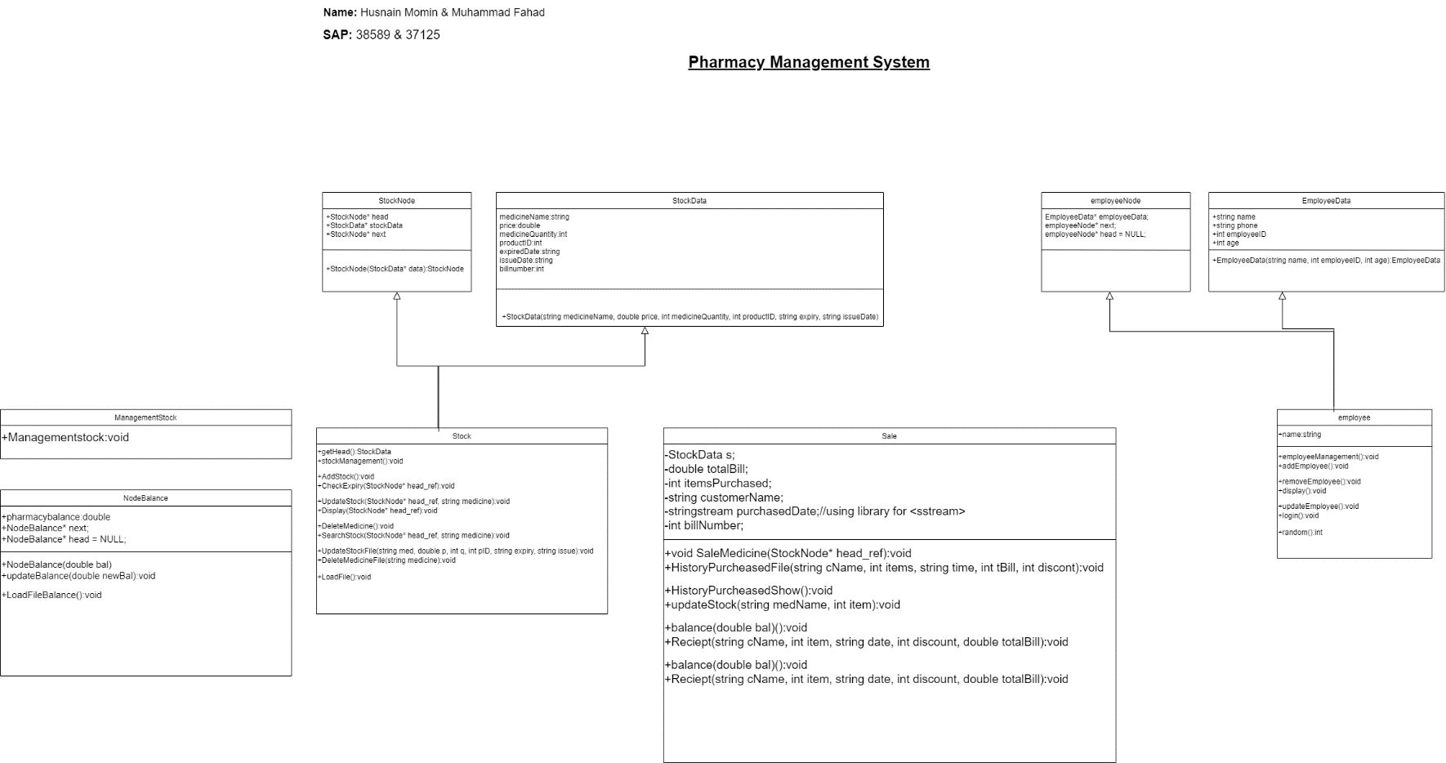
UML Diagram

Slide 9
Conclusion
You can efficiently manage any pharmacy and its employees using this program as it deals with a pharmacy’s issues in an optimal manner providing an efficient result.

Slide 10
Thank You!

